Slide 1
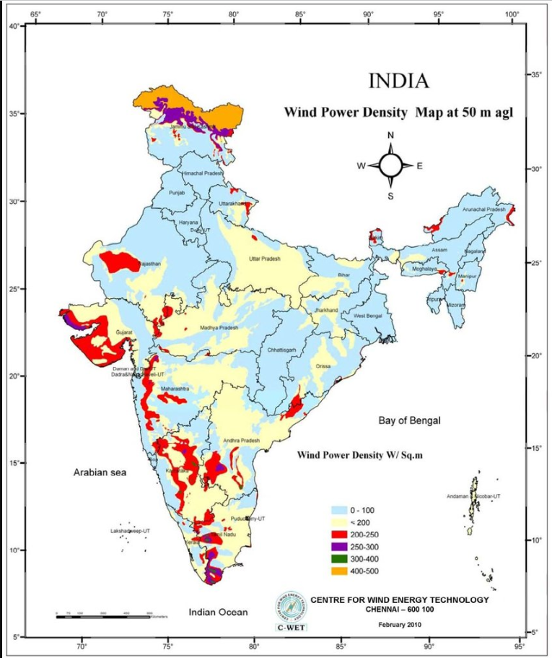
WIND Energy Potential Mapping in India
Group B39:
Harsh Prasad - 12621019025
Sarbartha Sankar Mallick- 12621019047
Debargha Saha - 12621019020
Dipsikha Bhaumik - 12621019023
Project Mentor:
Asst. Prof. Sabyasachee Banerjee

Slide 2
Why are we working with wind energy?
Non-renewable energy sources like coal and oil are depleting, increasing the demand for renewable energy.
India is the fourth-largest wind energy producer, with over 44 GW installed capacity.
Global wind power generation grew by 10% in 2017.
Government initiatives like the Wind-Solar Hybrid Policy and financial incentives support India's wind energy sector.
Accurate wind power forecasting is essential for affordable and reliable energy supply.

Slide 3
Objective of the Project
Dataset for Wind Farm Site Selection: Create a dataset with random geographic points and key environmental variables (wind speed, elevation, distance to coastlines) to optimize wind farm site selection.
Assessment of Wind Energy Potential: Analyze wind speed, elevation, and proximity to coastlines across Indian states using geospatial data to identify high-potential regions for wind energy development.

Slide 4
Dataset Creation and Extraction
Data Development in Python: Geographic and meteorological data specific to India were processed using Python.
Shapefile Integration: A shapefile (.shp) outlined India’s geography, storing attributes like elevation, wind speed, and weather characteristics.
TIFF Data Extraction: Raster files (TIFF) were used to extract environmental data, such as surface temperatures and elevation, using Python’s Raster library.
Coastal Proximity Analysis: Another shapefile was used to calculate the distance of data points from India’s coastline.
Sampling and Storage: 100 random data points were generated for each state/UT, with all data stored systematically in a CSV file for analysis.

Slide 5
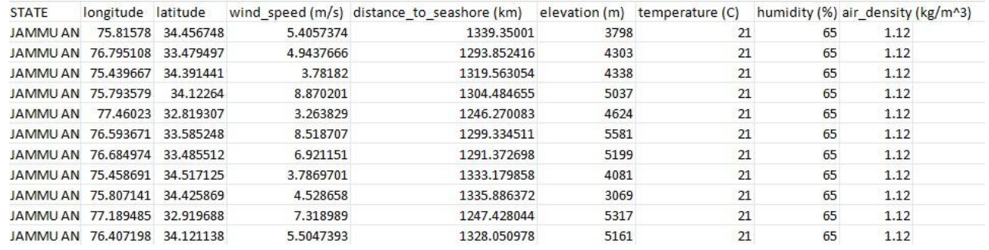
The dataset

Slide 6
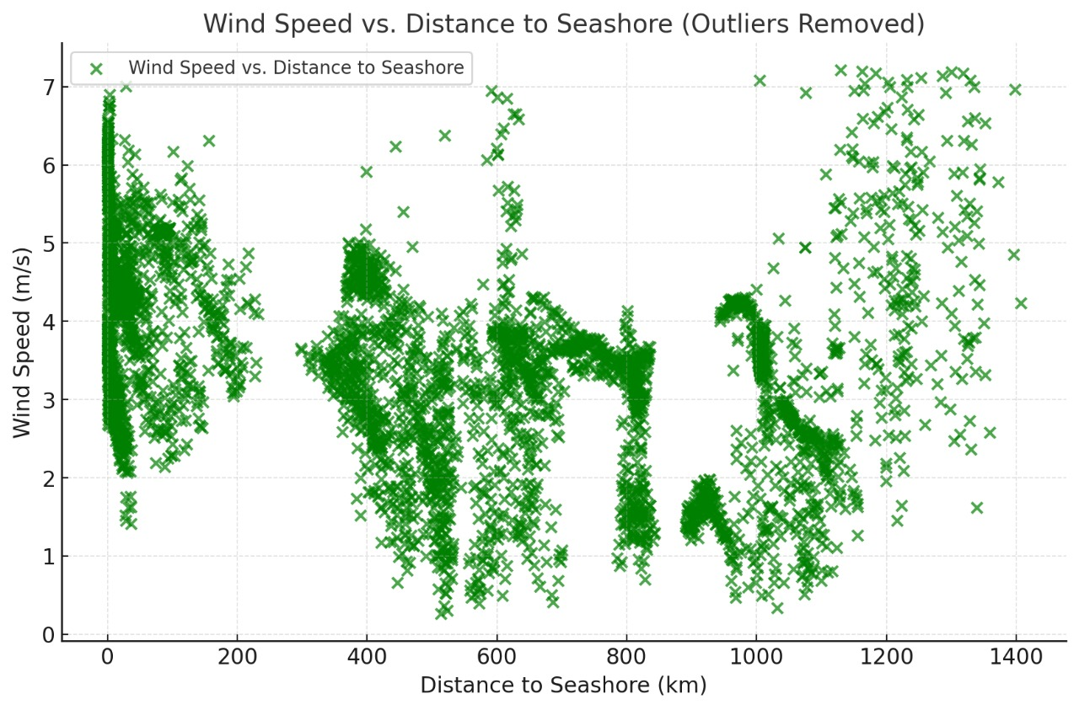
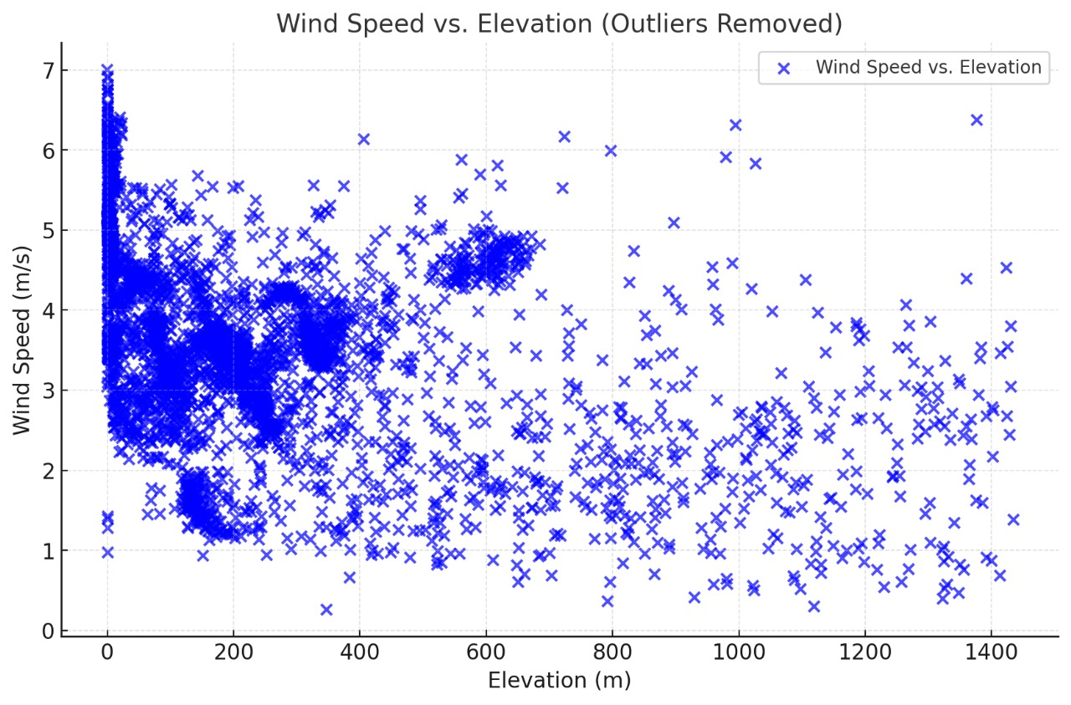
Major features in the dataset

Slide 7
PROPOSED SOLUTION
The wind speed, topographical, and environmental data is split into 80% training and 20% testing datasets for model validation.
A feedforward neural network is used to predict high wind-speed areas using features like elevation, latitude, and other features available.
Identify regions meeting wind speed thresholds.
Validate predictions against historical data, to verify results.

Slide 8
EXPERIMENTAL Procedure
Input Features: The model takes features like longitude, latitude, distance to seashore, elevation, temperature, humidity, and air density as input.
Feature Processing: These inputs are processed through hidden layers to learn patterns and relationships using non-linear transformations.
Output Prediction: The final layer outputs the predicted wind speed in meters per second.
Learning and Optimization: The model minimizes prediction errors during training using the Adam optimizer and Mean Squared Error loss.

Slide 9
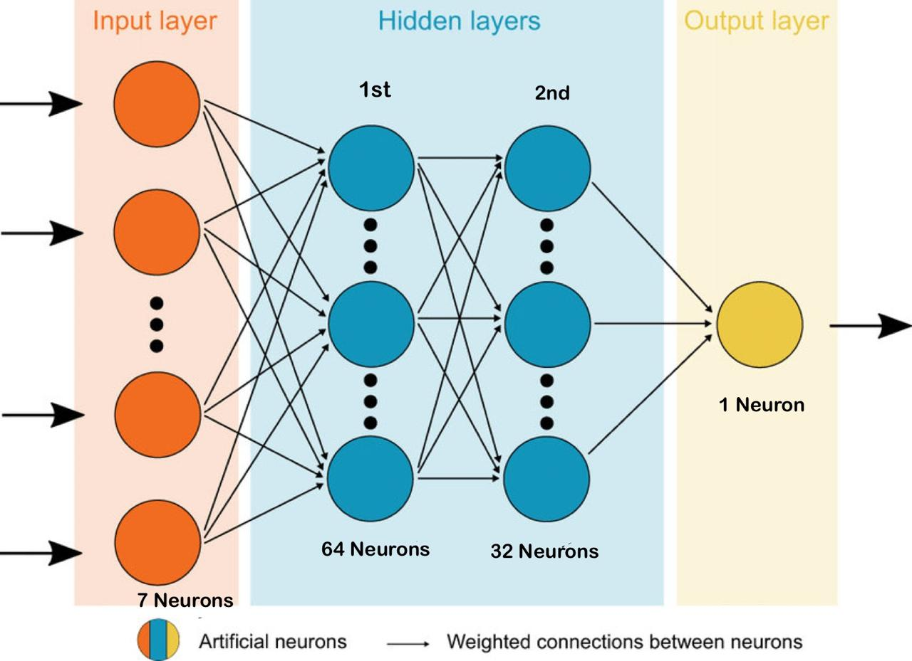
model architecture diagram

Slide 10
model architecture
A feedforward neural network with three layers: an input layer matching dataset features, two hidden layers (64 and 32 neurons, ReLU activations), and an output layer producing a single continuous value for regression tasks.
Uses the Adam optimizer for dynamic learning rate adjustment, Mean Squared Error (MSE) as the loss function, and Mean Absolute Error (MAE) as the evaluation metric.
Trained for 80 epochs with a batch size of 16 using 20% of training data for validation to monitor performance and mitigate overfitting.
Assessed on a test set with MSE and MAE, providing measures of model accuracy and interpretability in regression.
Non-linear ReLU activations for learning complex patterns, compact two-layer design for computational efficiency, and robust optimization for stable learning.

Slide 11
EXPERIMENTAL RESULTS
Accuracy | 85%
Mean Absolute Error (MAE) | 0.45
Mean Squared Error (MSE) | 0.49
Root Mean Squared Error(RMSE) | 0.70
R² | 0.78
Mean of target variable | 3

Slide 12
CONCLUSION
Here in this work, we present an ML-based model that will predict the wind speed of a certain location based on the aforementioned features.
Experimental results are promising with 85% accuracy.
We like to extend our work by gathering more data and would like to consider Solar exposure.

Slide 13
REFERENCES
[1] Chuan Huang; Changjian Liu; Ming Zhong; Hanbing Sun; Tianhang Gao;Yonglin Zhang. Research on Wind Turbine Location and Wind Energy Resource Evaluation Methodology in Port Scenarios. Sustainability 2024, 16, 1074
[2] A ShobanaDevi,; Dr.G Maragatham; MR Prabu; K Boopathi. Short-Term Wind Power Forecasting Using R-LSTM.INTERNATIONAL JOURNAL of RENEWABLE ENERGY RESEARCH A. Shobana Devi et al., Vol.11, No.1, March, 2021.
[3] TIFF- https://mppolytechnic.ac.in/mpstaff/notes_upload_photo/CS672TIFF. pdf
[4]https://www.indiaremotesensing.com/2017/01/download-india-shapefile-with-official.html#google_vignette
[5] https://datacatalog.worldbank.org/search/dataset/0039348

Slide 14
REFERENCES
[6] Vishal Maurya; Sushant Khare; Shrish Bajpai.Future Scope of Wind Energy in India. IOSR Journal of Electrical and Electronics Engineering (IOSR-JEEE) e-ISSN: 2278-1676,p-ISSN: 2320-3331, Volume 10, Issue 1 Ver. II (Jan – Feb. 2015), PP 79-83 www.iosrjournals.org DOI: 10.9790/1676-10127983
[7]https://www.researchgate.net/figure/Activation-function-ReLu-ReLu-Rectified-Linear-Activation_fig2_370465617
[8]https://levelup.gitconnected.com/understanding-mean-squared-error-a-practical-guide-for-data-scientists 4ec7de03ac0e
[9]https://medium.com/@polanitzer/the-minimum-mean-absolute-error-mae-challenge-928dc081f031
[10]https://www.google.com/url?sa=i&url=https%3A%2F%2Fwww.researchgate.net%2Ffigure%2FSketch-of-a-feed-forward-artificial-neural-network-ANN-with-one-input-layer-two-hidden_fig4_333396589&psig=AOvVaw0t3RsdosI__-L-p2M_c84I&ust=1733506877135000&source=images&cd=vfe&opi=89978449&ved=2ahUKEwiP9qS-lpGKAxWycmwGHRo8HM8QjRx6BAgAEBk

Slide 15
THANK YOU!

